Slide 1
Presentation on interNship work on PythoN and Machine learning
Presented by:
G.Sai Teja
VII Semester
Dept. of ECE, SITE

Slide 2
Table of Contents
College Name
Company Profile
Topics covered in Internship
Introduction to Domain(Machine Learning)
Types of Machine Learning
Projects Done
Methodology and Explanation
Skills adopted during Internship
Conclusion

Slide 3
Sasi Institute of Technology & Engineering,Tadepalligudem

Slide 4
COMPANY INTRODUCTION
Company Name: Karunadu Technologies Private Limited.
Location: Bangalore, Karnataka, India.
Company Main Objective: To Empower Unskilled Individual with knowledge, skills and technical competencies in the field of Information Technology and Embedded engineering which assist them to escalate as integrated individuals contributing to company’s and Nation’s growth.
Internship Duration: Sep-Oct 2021 (6-weeks).
Internship Mentor: Sunil S.
Domains:Python With Machine Learning.
Machine Learning Platforms: Jupyter Notebook.

Slide 5
Topics Covered In Internship
Basics of Python
Introduction and implementation of numpy, matplotlib, open cv library
Image Processing: Face detection and eye detection in an image using haarcascades
Working with video file, Face and eye detection in a video file
Introduction of PyQt5, creating window application using PyQt5
Introduction to Machine Learning domain and its types
Application of Linear Regression and Multilinear Regression algorithms
Application of Logistic Regression and KNN algorithms
Application of Decision Tree and SVM algorithms

Slide 6
Basics of Python
Introduction
Keywords and variables
Libraries and statements
Datatypes and Operators
Loop Statements
Functions
Lamba Functions
Modules
Packages
Files

Slide 7
Definition of matplotlib
What is Matplotlib Pyplot in Python?
matplotlib. pyplot is a collection of functions that make matplotlib work like MATLAB. Each pyplot function makes some change to a figure: e.g., creates a figure, creates a plotting area in a figure, plots some lines in a plotting area, decorates the plot with labels, etc. In matplotlib.

Slide 8
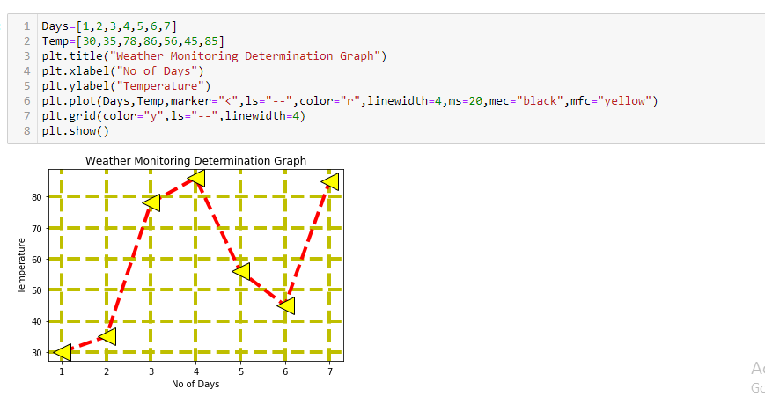
weather Monitoring using Matplotlib

Slide 9
program for live streaming using opencv
#live video stream
import cv2 #read the video
path="C:\\Users\\VAIO\\Desktop\\PYQT5\\opencv\\Images\\carsvideo.mp4"
capture=cv2.VideoCapture(0) #10 sec
while capture.isOpened():
ret,frame= capture.read()# rect-1 is the video is read successfully o-if video is not reading
#video frame by frame
if ret==0:
break;
cv2.imshow('Video read',frame)
if cv2.waitKey(1)==ord('q'):
break
capture.release()
cv2.destroyAllWindows()

Slide 10
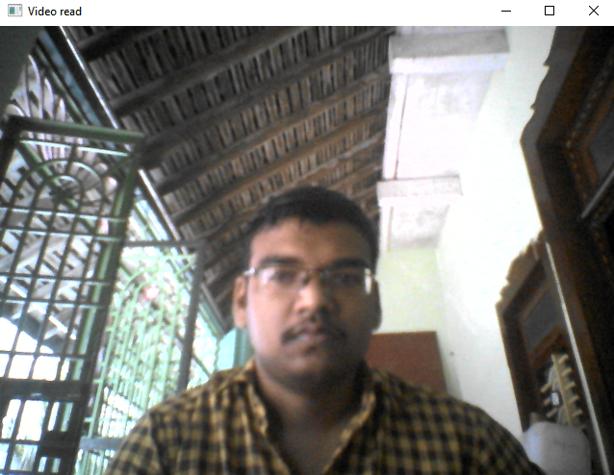
Video Streaming using opencv

Slide 11
Application on linear regression
import pandas as pd
import matplotlib.pyplot as plt #used for plotting the graphs
import sklearn #machine learning librar
from sklearn import linear_model #importing only linear model
dir(pd)
path="C:\\Users\\VAIO\\Desktop\\PYQT5\\ML\\homeprices.csv" #path of the file
data = pd.read_csv(path)#read_csv function is used ---Used to read the file
print(data)
inputs=data.drop('price','columns')
print(inputs)
output=data.drop('area','columns')
print(output)
plt.scatter(inputs,output) #plotting the graph
model = linear_model.LinearRegression()# intialize the model
model.fit(inputs,output)#training the model
result= model.predict([[4600]]) #predicing the value of the price for given area
print(result)
acc=model.score(inputs,output)
print(acc*100)
print(model.intercept_)
print(model.coef_)

Slide 12
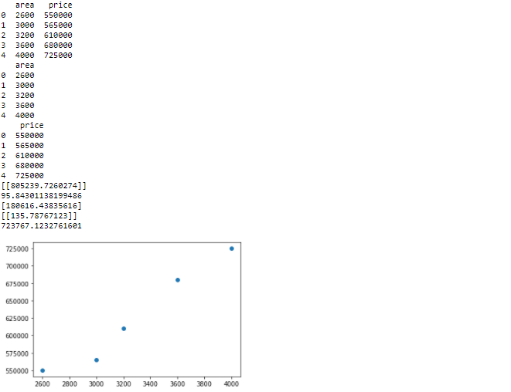
OUTPut of linear Regression

Slide 13
Introduction to Machine Learning
Machine Learning is a field of Computer Science that makes computers to learn from experience like human beings or animals.
ML algorithms make data-driven predictions or decisions by building mathematical models from empirical data.
There are three type of Machine Learning algorithms
i) Supervised Learning
ii) Unsupervised Learning
iii) Reinforcement Learning

Slide 14
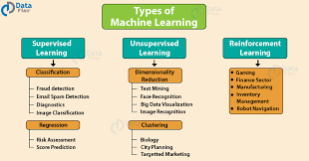

Slide 15
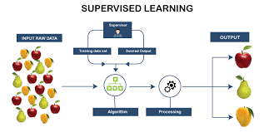
Supervised Learning

Slide 16
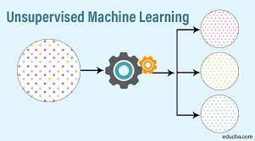
Unsupervised Learning

Slide 17
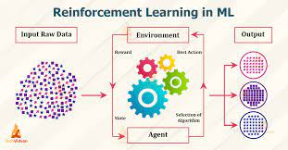
Reinforcement Learning

Slide 18
Projects To Be Implemented:
Predicting the customer would buy the Magazine or not in Magazine Dataset by using KNN Algorithm.

Slide 19
knn Agorithm
The k-nearest neighbors (KNN) algorithm is a simple, supervised machine learning algorithm that can be used to solve both classification and regression problems. It's easy to implement and understand, but has a major drawback of becoming significantly slows as the size of that data in use grows.
What is the use of KNN algorithm?
KNN is one of the simplest forms of machine learning algorithms mostly used for classification. It classifies the data point on how its neighbor is classified. KNN classifies the new data points based on the similarity measure of the earlier stored data points. For example, if we have a dataset of tomatoes and bananas.

Slide 20
MagAzine Prediction
Objectives : To Predict Magazine can be bought or not
Software used: Anaconda, Jupyter notebook
Algorithm used: KNN Algorithm
How to:
i. Read the csv file using pandas opencv() function.
ii. Apply Data preprocessing technique to clean the data.
iii. Divide data set into x and y; x having independents value and y having dependents variables.
iv. Further dividing x and y into x_test, x_train and y_test, y_train respectively using train_test_split().
v. Importing and applying KNN Algorithm model as from sklearn.model_selection import train_test_split

Slide 21
code For magizine prediction:
import pandas as pd
import sklearn
from sklearn.model_selection import train_test_split
path="C:\\Users\\VAIO\\Desktop\\PYQT5\\ml1\\LogisticRegression\\Magzine\\Kid.csv"
data=pd.read_csv(path)
print(data)
inputs=data.drop(['Buy'],'columns')
output=data.drop(['Obs No.','Income','Is Female','Is Married','Has College','Is Professional','Is Retired',
'Unemployed','Residence Length','Dual Income','Minors','Own','House','White',
'English','Prev Child Mag','Prev Parent Mag'],'columns')
print(inputs)
print(output)
x_train,x_test,y_train,y_test=train_test_split(inputs,output,train_size=0.8)

Slide 22
print(x_train)
print(x_test)
print(y_train)
print(y_test)
from sklearn.neighbors import KNeighborsClassifier
model=KNeighborsClassifier(n_neighbors=13)
#train
model.fit(x_train,y_train)
y_pred=model.predict(x_test)
print(y_pred)
print(y_test)
from sklearn.metrics import confusion_matrix
cm=confusion_matrix(y_test,y_pred)
print(cm)
result=model.predict([[11,75000,1,0,1,0,0,0,13,1,0,0,0,1,1,0,0]])
print(result)

Slide 23
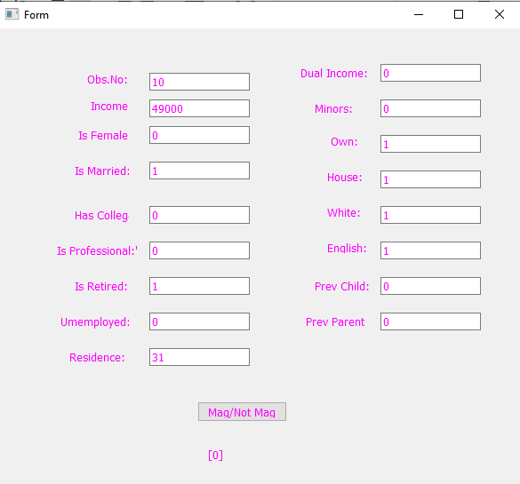
Output1:

Slide 24
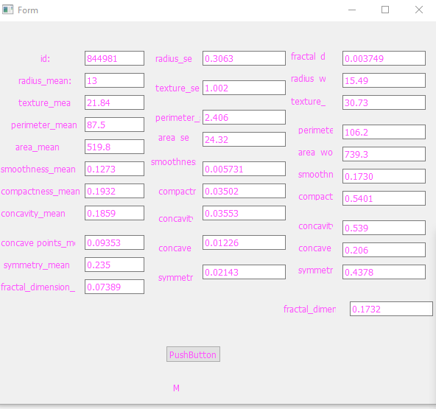
output:2

Slide 25
Conclusion
The company gave a broad spectrum of knowledge in the domain of Machine Learning which required us to learn more about the machine learning.
Work on different cross-platforms and different Python libraries which done my Python Programming skills and Data Analyst skills.
Helped to acquire knowledge about work-culture of Corporate IT sector in India.

